Slide 1


Searching via non-preferred terms in Alma
Yoel Kortick
Senior Librarian

Slide 2
Copyright Statement
All of the information and material inclusive of text, images, logos, product names is either the property of, or used with permission by Ex Libris Ltd. The information may not be distributed, modified, displayed, reproduced – in whole or in part – without the prior written permission of Ex Libris Ltd.
TRADEMARKS
Ex Libris, the Ex Libris logo, Aleph, Alma, SFX, SFXIT, MetaLib, DigiTool, Verde, Primo, Voyager, MetaSearch, MetaIndex and other Ex Libris products and services referenced herein are trademarks of Ex Libris, and may be registered in certain jurisdictions. All other product names, company names, marks and logos referenced may be trademarks of their respective owners.
DISCLAIMER
The information contained in this document is compiled from various sources and provided on an "AS IS" basis for general information purposes only without any representations, conditions or warranties whether express or implied, including any implied warranties of satisfactory quality, completeness, accuracy or fitness for a particular purpose.
Ex Libris, its subsidiaries and related corporations ("Ex Libris Group") disclaim any and all liability for all use of this information, including losses, damages, claims or expenses any person may incur as a result of the use of this information, even if advised of the possibility of such loss or damage.
© Ex Libris Ltd., 2011

Slide 3
Agenda
Introduction | I.
The Setup | II.
The Functionality – example 1 | III.
The Functionality – example 2 | IV.
The Functionality – example 3 | V.

Slide 4
Introduction
Searching via non-preferred terms in Alma allows the staff user to find records which have a bibliographic heading which is a preferred term even when searching by the non-preferred term.
This functionality works for all authority records regardless of
  The vocabulary
  Whether or not the authority record is global or local
This functionality also exists in Primo. For more about this functionality in Primo see Primo and Alma - Publishing non-preferred terms to Primo.pptx

Slide 5
Introduction
For example if a bibliographic record has subject heading "Æviþættir" and it is linked to local subject authority record heading for "Æviþættir" then search by subject "Ævisögubrot" will also find the title.
This is because "Æviþættir" is a non-preferred term for "Ævisögubrot"

Slide 6
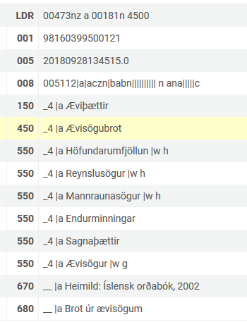
Introduction
Local subject Authority record
Find records in Alma with subject "Æviþættir"
Search Alma for subject "Ævisögubrot"

Slide 7
Introduction
Another example: if a bibliographic record has author heading "Wolf, Naomi" and it is linked to the LCNAMES authority heading for "Wolf, Naomi" then search by subject "Vulʹf, Naomi" will also find the title.
This is because "Vulʹf, Naomi" is a non-preferred term for "Wolf, Naomi"

Slide 8
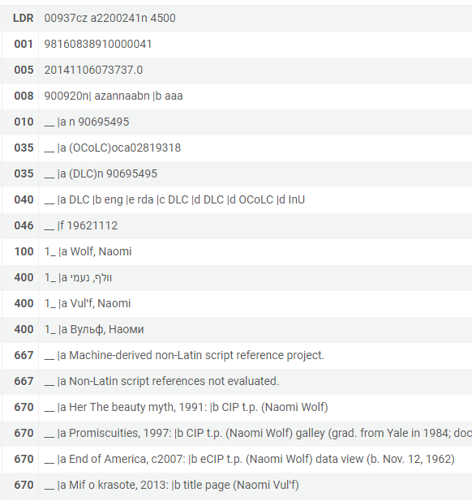
Introduction
LCNAMES Authority record
Find records in Alma with name "Wolf, Naomi"
Search Alma for name "Vulʹf, Naomi"

Slide 9
Introduction
Another example: if a bibliographic record has subject heading "Library science" and it is linked to the LCSH authority heading for "Library science" then search by subject "Librarianship" will also find the title.
This is because "Librarianship" is a non-preferred term for "Library science"

Slide 10
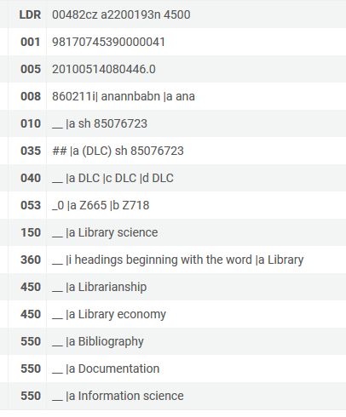
Introduction
LCSH Authority record
Find records in Alma with subject "Library science"
Search Alma for subject "Librarianship"

Slide 11
Agenda
Introduction | I.
The Setup | II.
The Functionality – example 1 | III.
The Functionality – example 2 | IV.
The Functionality – example 3 | V.

Slide 12
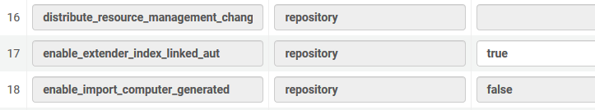
The Setup
There is one parameter necessary to set.
Under "Configuration > resources > General > Other settings" set enable_extender_index_linked_aut to "true"

Slide 13
The Setup
You can read more about enable_extender_index_linked_aut in the on line help.
After the parameter is set to "true" you will need to wait until the repository is indexed for it to work on previously-existing records. As explained here, "every six months, Ex Libris re-indexes all inventory data in order to enhance Alma's search mechanism."

Slide 14
Agenda
Introduction | I.
The Setup | II.
The Functionality – example 1 | III.
The Functionality – example 2 | IV.
The Functionality – example 3 | V.

Slide 15
The Functionality – example 1
In the next slide we see that title "As I was moving ahead occasionally I saw brief glimpses of beauty" has subject heading "Æviþættir"
Subject heading "Æviþættir" is linked to a local Icelandic authority heading
The authority heading has
  Preferred term "Æviþættir"
  Non-preferred term "Ævisögubrot"

Slide 16
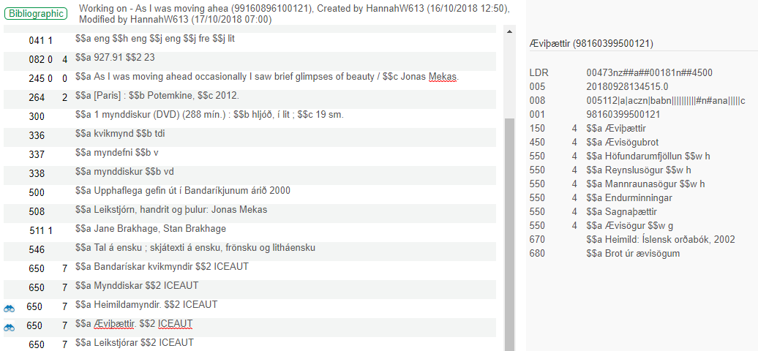
The Functionality – example 1
Preferred
Non-Preferred

Slide 17
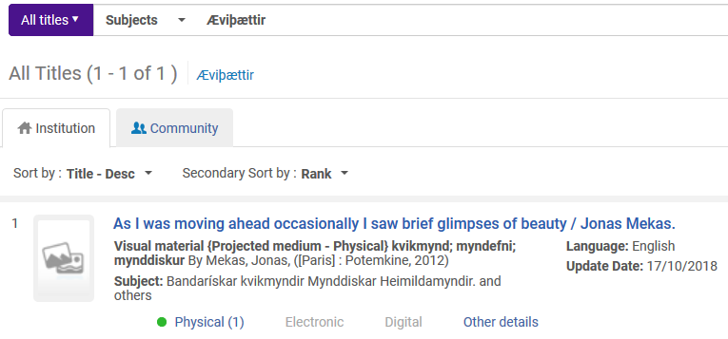
The Functionality – example 1
The record is found if staff user searches for subject with preferred term "Æviþættir"

Slide 18
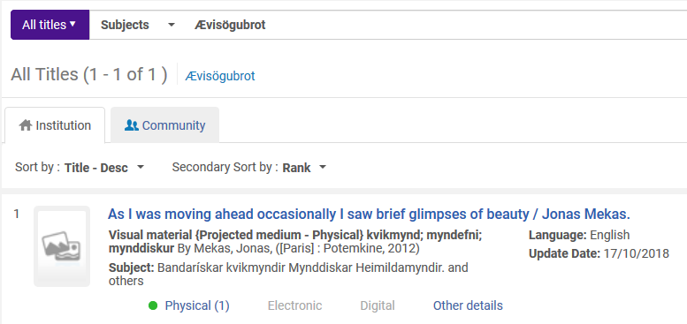
The Functionality – example 1
And the record is also found if staff user searches for subject with non-preferred term "Ævisögubrot"

Slide 19
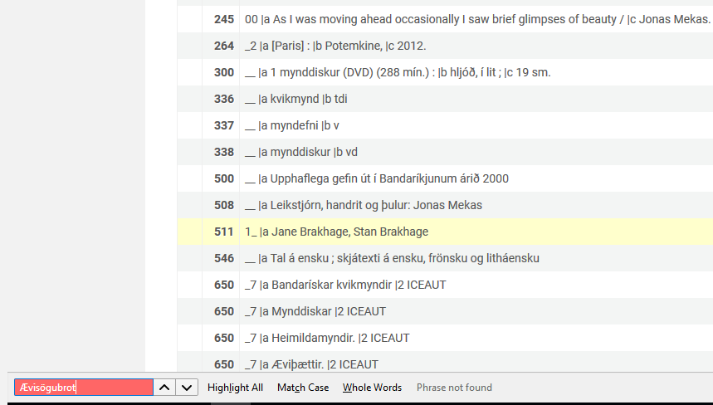
The Functionality – example 1
The record is found even though non-preferred term "Ævisögubrot" does not exist in the record

Slide 20
Agenda
Introduction | I.
The Setup | II.
The Functionality – example 1 | III.
The Functionality – example 2 | IV.
The Functionality – example 3 | V.

Slide 21
The Functionality – example 2
In the next slide we see that title "Promiscuities: the secret struggle for womanhood" has author heading "Wolf, Naomi."
Author heading "Wolf, Naomi." is linked to a LCNAMES authority heading
The authority heading has
  Preferred term "Wolf, Naomi."
  Non-preferred term "Vulʹf, Naomi"

Slide 22
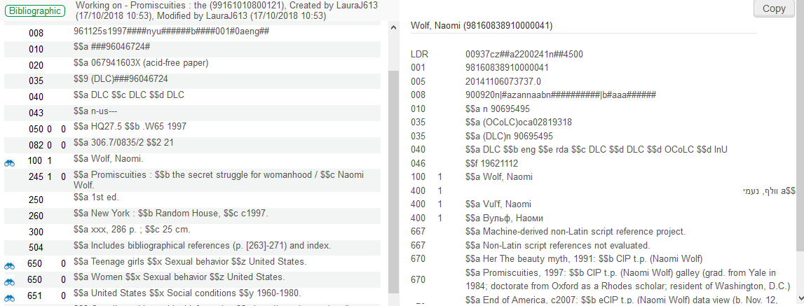
The Functionality – example 2
Preferred
Non-Preferred

Slide 23
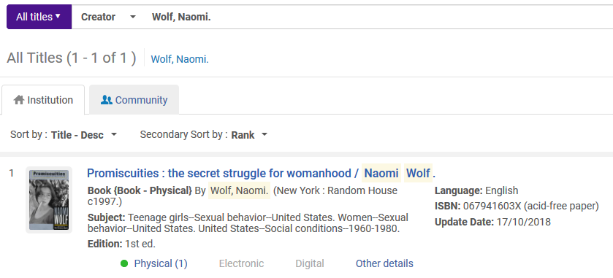
The Functionality – example 2
The record is found if staff user searches for creator with preferred term "Wolf, Naomi."

Slide 24
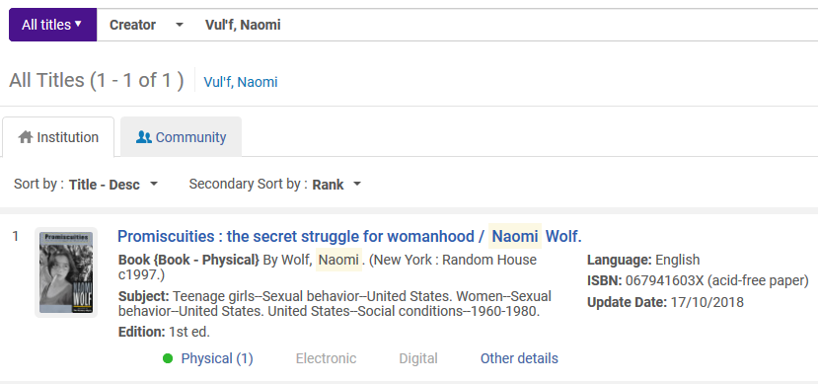
The Functionality – example 2
And the record is also found if staff user searches for creator with non-preferred term "Vulʹf, Naomi"

Slide 25
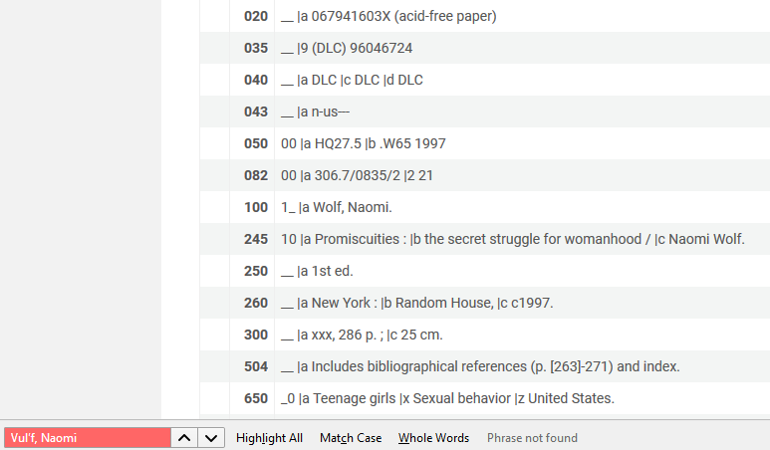
The Functionality – example 2
The record is found even though non-preferred term "Vulʹf, Naomi" does not exist in the record

Slide 26
Agenda
Introduction | I.
The Setup | II.
The Functionality – example 1 | III.
The Functionality – example 2 | IV.
The Functionality – example 3 | V.

Slide 27
The Functionality – example 3
In the next slide we see that title "She was a booklegger: remembering Celeste West" has subject heading "Library science."
Subject heading "Library science." is linked to a LCSH authority heading
The authority heading has
  Preferred term "Library science."
  Non-preferred term "Librarianship"

Slide 28
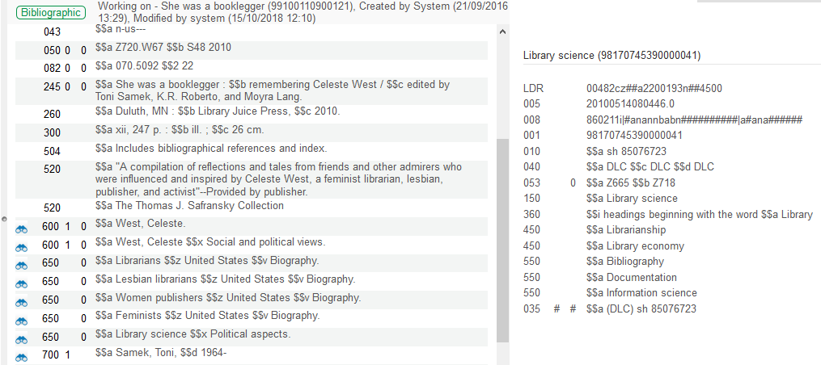
The Functionality – example 3
Preferred
Non-Preferred

Slide 29
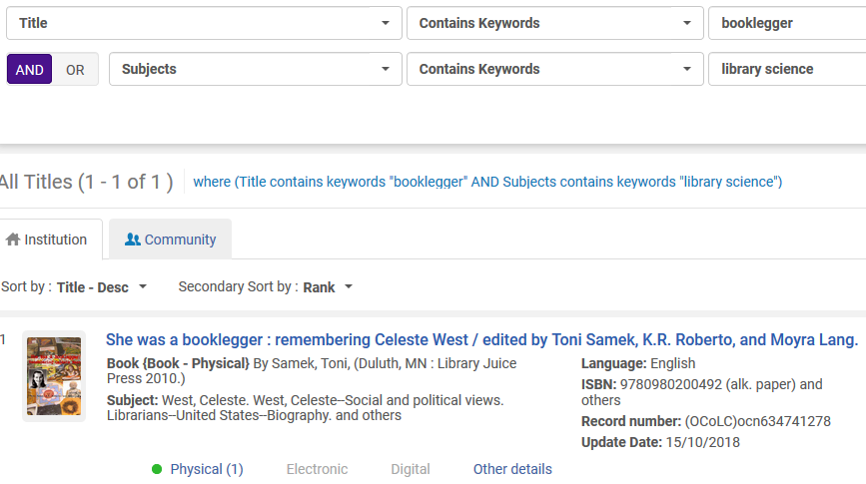
The Functionality – example 3
The record is found if staff user searches for subject with preferred term "Library science."

Slide 30
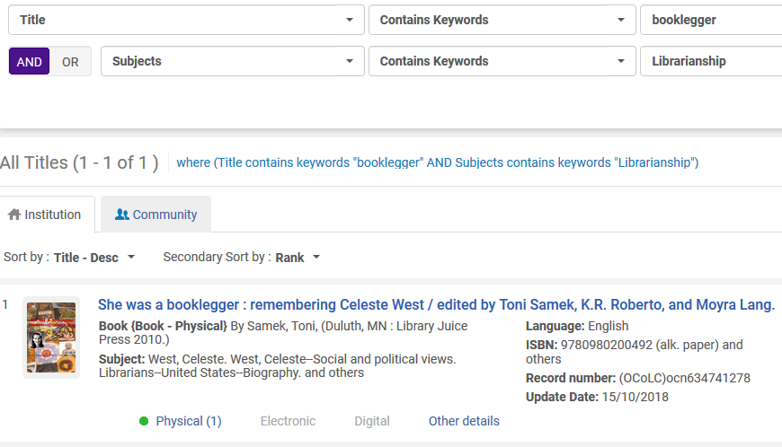
The Functionality – example 3
And the record is also found if staff user searches for creator with non-preferred term "Librarianship"

Slide 31
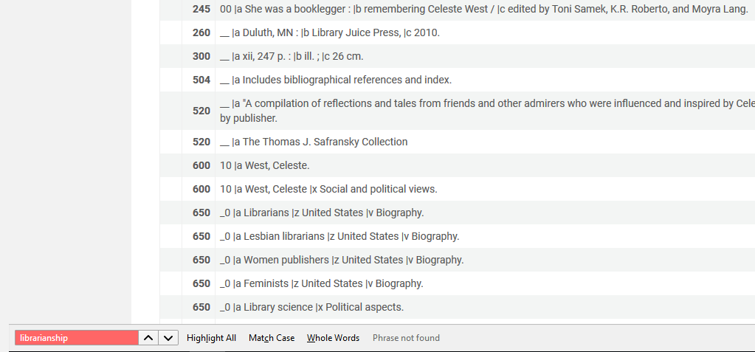
The Functionality – example 3
The record is found even though non-preferred term "Librarianship" does not exist in the record

